Slide 1
Optimizing Apache Spark Optimizing with AQE & DPP Skew Join Optimizations

Slide 2
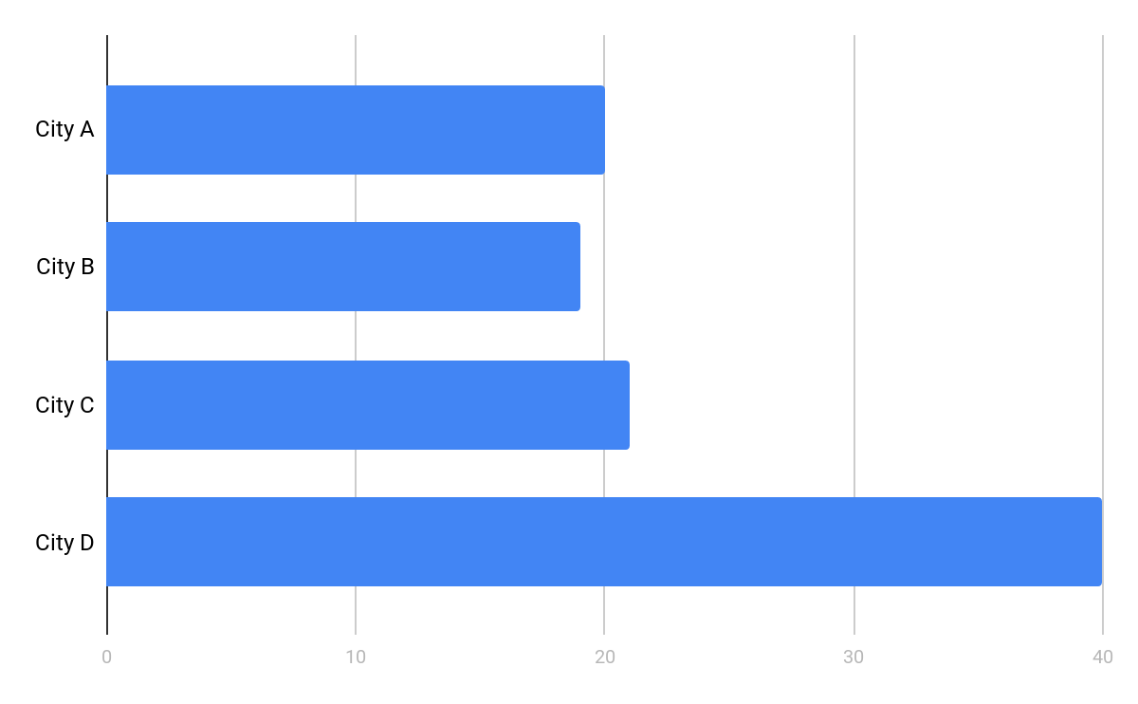
Optimizing with AQE & DPP
AQE - Optimizing Skew Joins
Skew is a hard problem to solve for
Just to review, we can:
Salt the skewed keys
Employ skew hints
Tweak all kinds of settings:
Level of Compute
Available RAM for Execution
The Broadcast-Join Threshold
spark.sql.shuffle.partitions
Or we can just use Spark 3.x...

Slide 3
Optimizing with AQE & DPP
AQE - Optimizing Skew Joins
With Spark 3.x, solving for skew is easy and automatic:
Enable by setting spark.sql.adaptive.skewJoin.enabled to true
A partition is skewed if its data size or row count is N times larger than the median & also larger than a predefined threshold
When skewed, AQE subdivides the one partition into many partitions and employs additional tasks to process
For example...
Partition 1 (50 MB)
Partition 1 (50 MB)
Partition 1 (50 MB)
Partition 2 (50 MB)
Partition 2 (50 MB)
Partition 2 (50 MB)
Partition 3 (50 MB)
Partition 3 (50 MB)
Partition 3 (50 MB)
Partition 4 (50 MB)
Partition 4 (50 MB)
Partition 4 (50 MB)
Partition 5 (90 MB)
Partition 5 (90 MB)
Partition 5-A (45 MB)
Partition 5-B (45 MB)
Partition 6 (150 MB)
Partition 6 (150 MB)
Partition 6-A (50 MB)
Partition 6-B (50 MB)
Partition 6-C (50 MB)

Slide 4
Optimizing with AQE & DPP
AQE - Optimizing Skew Joins, In Action
See Experiment #1596
Contrast the last job for Step C (standard) and Step E (w/AQE)
...the total execution time (entire command)
...the number of tasks for the final stage of each job
...the stage details for the final stage of each job
Event Timeline
Presence or absence of Spill
Shuffle Read Size / Records
..the query plans for the two jobs
What major difference is there in the Query Plan for Step C vs Step E?
How many skewed partitions were reported in the Query Plan?

Slide 5
Optimizing with AQE & DPP
AQE - Optimizing Skew Joins, Review
Step | Cmd Duration | Tasks | Event Timeline | Spill | Shuffle Read Size / Records | Skew Count | Query Plan Optimization
C | ~29 min | 832 | Bad | Yes | 0/0/<100K/<500M/2.6G | n/a | -none-
E | ~25 min | 1489 | Good | No | 0/115M/115M/125M/130M | 1,327 | CustomShuffleReader SortMergeJoin(skew)

Slide 6
Optimizing with AQE & DPP
Optimizing Skew Joins - Options
See Optimizing Skew Join for more information
Property Name | Default | Meaning
spark.sql.adaptive.skewJoin.enabled | true | When true and spark.sql.adaptive.enabled is true, Spark dynamically handles skew in sort-merge join by splitting (and replicating if needed) skewed partitions.
spark.sql.adaptive.skewJoin.skewedPartitionFactor | 10 | A partition is considered as skewed if its size is larger than this factor multiplying the median partition size and also larger than spark.sql.adaptive.skewedPartitionThresholdInBytes
spark.sql.adaptive.skewJoin.skewedPartitionThresholdInBytes | 256 MB | A partition is considered as skewed if its size in bytes is larger than this threshold and also larger than spark.sql.adaptive.skewJoin.skewedPartitionFactor multiplying the median partition size. Ideally this config should be set larger than spark.sql.adaptive.advisoryPartitionSizeInBytes.
Notes:
UNPUBLISHED - As of writing this course (05-27-2020), the following options have yet to be published

